Slide 1
Technovation 2.0 Datathon
Team KUET_DATARangers

Slide 2
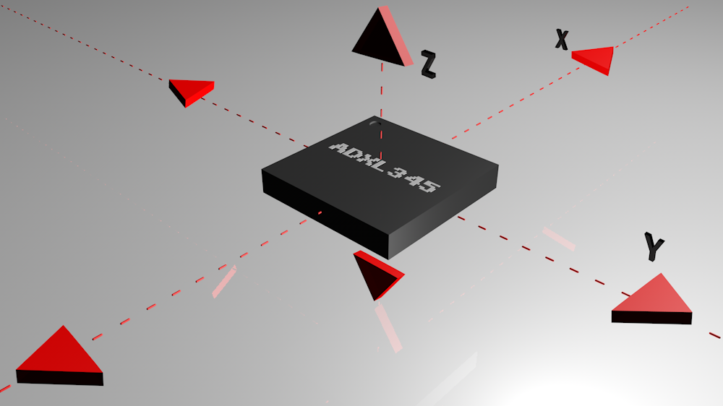
Introduction
The problem was about the measurement of human activity according to the accelerometer data.
Overview:
1.Pre-processing
2.Exploratory data analysis
3.Data Visualization
4.Feature Engineering : Feature selection with GA
5.FINAL model : Adaboost ensembled with RF

Slide 3
Methodology
Data Pre-processing:
Divide the data into 4 chunks
Data concatenation
Missing Value Checking and elimination
Statistical Method calculation i.e.
Mean
Max
Median
Variance
Standard Deviation
Label Encoding.

Slide 4
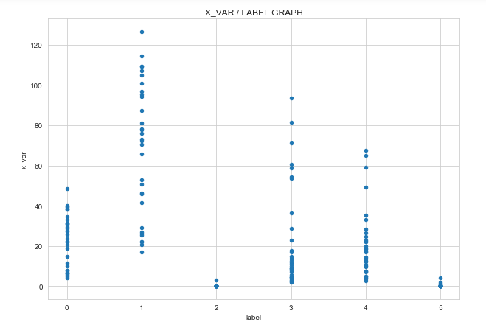
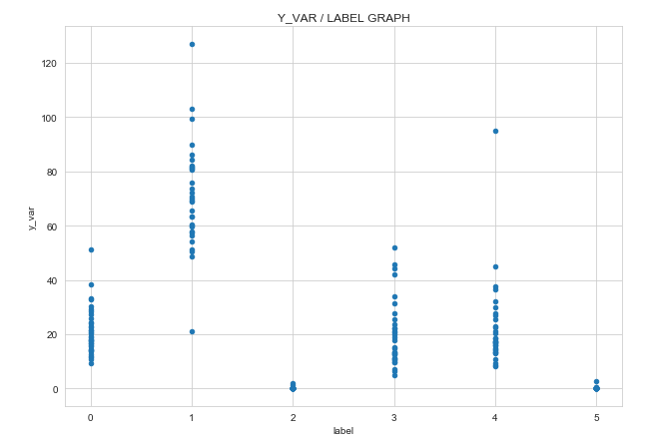
Methodology
Data Visualization:
0-walking,3-downstairs,4-upstairs,2-standing,5-sitting,1-joggling

Slide 5
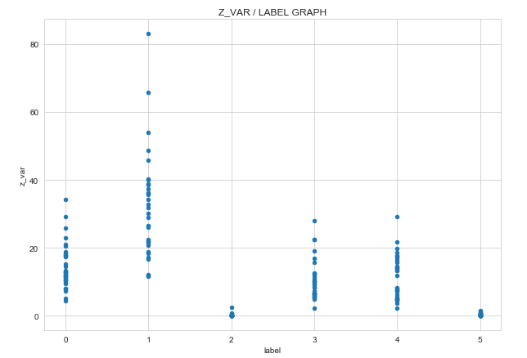
Methodology
Data Visualization:
0-walking,3-downstairs,4-upstairs,2-standing,5-sitting,1-joggling

Slide 6
Result
3 CLASS CONSIDARATION:
Movement : walking + downstairs + upstairs
Jogging
Steady-state: Sitting + Standing
Accuracy of 3-class Consideration:
Adaboost with Random Forest: 96.64%
RandomForest without Adaboost: 88.84%
SIX CLASS CONSIDARATION:
Accuracy:
Adaboost : 66.67%
RandomForest without feature selection: 67.6%
Feature selection with GA(10 selected from 21)
5-fold cv :74.3%

Slide 7
Thank You

